Slide 1
ADVANCING NETWORK SECURITY: POST – QUANTUM ENCRYPTION
TEMIRLAN ZHAXALYKOV
KAZAKH – BRITISH TECHNICAL UNIVERSITY

Slide 2
TABLE OF CONTENTS
01
02
03
New directions of cryptography
Post-Quantum NIST Competition
Who is Peter Shor? What did he break ?

Slide 3
TABLE OF CONTENTS
04
05
06
Modern Implementations and Standards
Recommended Cautions
Post – Quantum Encryption and Digital Signatures

Slide 4
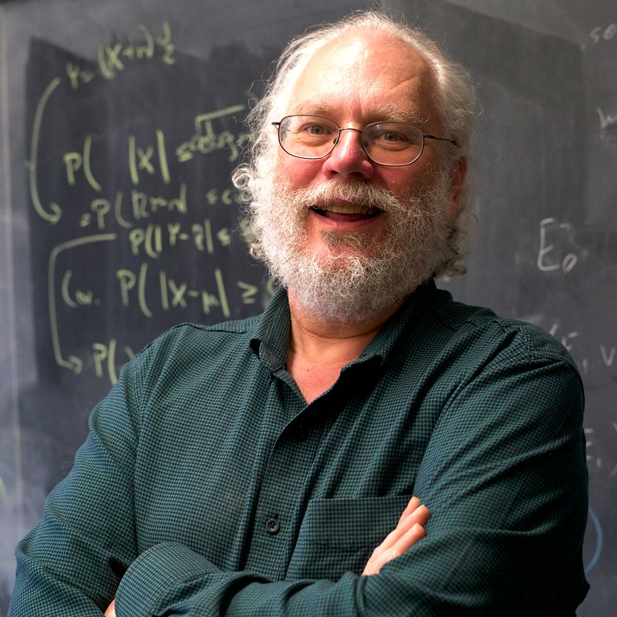
WHO IS PETER SHOR ?
WHAT DID HE BREAK ?
Peter Shor is a mathematician who solved the problem of the insolvability of the problems of factorization of large primes and the discrete logarithm, thereby finding a security hole in modern asymmetric encryption.

Slide 5
NEW DIRECTIONS OF CRYPTOGRAPHY
POST QUANTUM CRYPTOGRAPHY
QUANTUM CRYPTOGRAPHY
development of cryptographic systems for classical computers that can prevent attacks launched by quantum computers
is a method of encryption that uses the naturally occurring properties of quantum mechanics to secure and transmit data in a way that cannot be hacked.

Slide 6
POST – QUANTUM NIST COMPETITION
February 2016
2023
2015
2022
NIST Round 3 Submission Process
ETSI was the first major public body to seriously explore quantum-resistant ciphers.
NIST Post-Quantum Cryptography Standardization Process
NIST Round 4 Submission Process

Slide 7
POST – QUANTUM CRYPTOGRAPHY AND DIGITAL SIGNIATURES
ENCRYPTION
DIGITAL SIGNATURES
BIKE
CLASSIC MCELIECE
HQC
CRYSTAL – DILITHIUM
FALCON
SPHINCS+

Slide 8
BIKE
01
Bit Flipping Key Encapsulation

Slide 9
BIKE
Features:
Using the Lizard Scheme
Durability and technical details:
Application
Security with Quantum Computing
Speed and Efficiency

Slide 10
02
CLASSIC MCEILECE

Slide 11
CLASSIC MCELIECE
Features:
Relation to NP-complete problems
Keys size
Application
Uses Goppa codes Long-term persistence

Slide 12
HQC
03
Hamming Quasi - Cyclic

Slide 13
HQC
Features:
Quasi-cyclic Hamming codes
Secret and open space
Application
Quantum Resilience Performance

Slide 14
Recommended Cautions
Algorithm selection
Persistence
Performance
Integration
Standardization
Post-quantum hardness
1
2
3
4
5
6

Slide 15
Do you have any questions?
t.zhaxalykov@kbtu.kz
THANKS FOR ATTENTION

